Slide 1
Social Security
Challenges and Opportunities ahead
Notes:
Thank you for inviting me to be here tonight, for the delicious dinner and good company, and for the opportunity to talk with you about this important issue.
My name is Aaron Keating, and I know you’ve got my biography there so I won’t repeat it for you, but I will give you a brief overview of the organization I work for.

Slide 2
Economic Opportunity Institute
Independent, nonpartisan,
non-profit organization.
Working to advance new public policies via research, education and advocacy.
Building an economy that works for everyone.
Minimum Wage
Paid Sick Days
Paid Family & Medical Leave
Gender Pay Equity
Health Care
Retirement Security
Early Childhood Education
Higher Education
Progressive tax reform
Notes:
The Economic Opportunity Institute was founded in 1998, and I’ve worked there since 2007. We work to advance new public policies via research, education and advocacy that help build an economy that works for everyone.

Slide 3

Social Security: A Brief History

Slide 4
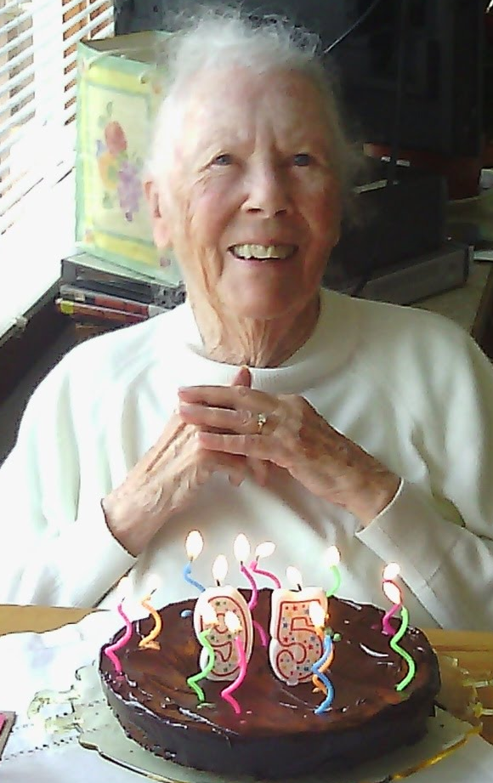


Social Security and my family
Notes:
This is my beloved (and dearly departed) grandmother Doris. Born in 1918, she grew up during the Great Depression, and saw the birth of Social Security in 1935. She also gave birth to 10 children – and when my grandfather, who was a linotypist in the Chicago area, died in 1972, Social Security was an absolute lifeline. She still had elementary-age children in the house!
This is my father, Patrick, 3rd child of Doris and a retired reading teacher. Social Security and Medicare mean he doesn’t live in need, but is enjoying a dignified retirement – and the occasional fishing trip with his buddies.
And here is my wife Annie with my daughter Ruby. We don’t receive direct benefits from Social Security, but – like 95% of Washington’s working families – it is there in case something happens to me or to Annie that would prevent us from working and earning income.
I know each of you has stories like this of your own. Let’s wind the clock back a bit now, and see what life would have been like for someone like my grandmother, or father, or my own family, before Social Security existed.

Slide 5
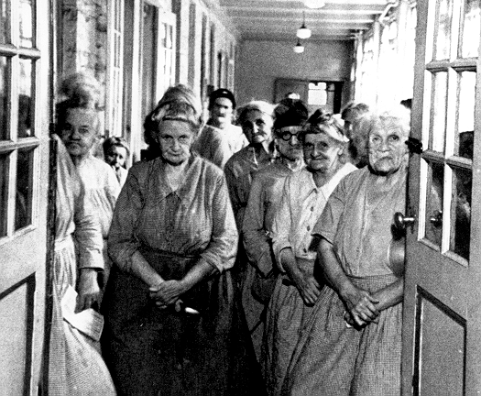
Life before Social Security
Most people worked until they were no longer able. Family might care for them, they might have to beg, or hope for private charity.
Colonial-era “Poor Laws”
18th and 19th century: Almshouse or poorhouse
Civil War Pension Program
Company pensions
Notes:
Poor Laws featured local taxes to support the destitute deemed “worthy”, as determined by town elders.
During the 18th and 19th century, almshouses and poorhouses were funded by states for the poorest in society. They were made to be as unpleasant as possible to "discourage" dependency. Those receiving relief could lose their personal property, the right to vote, the right to move, and in some cases were required to wear a large "P" on their clothing to announce their status.
The Civil War Pension Program began in 1862, and by 1910 had expanded such that Civil War veterans (of the North) and their survivors could receive disability, survivors and old-age benefits, but this precedent did not extend to general society.
Company pensions were often granted or withheld at the option of the employer, so most workers would never see a one. As of 1932, only about 5% of the elderly were receiving retirement pensions from a former employer.

Slide 6
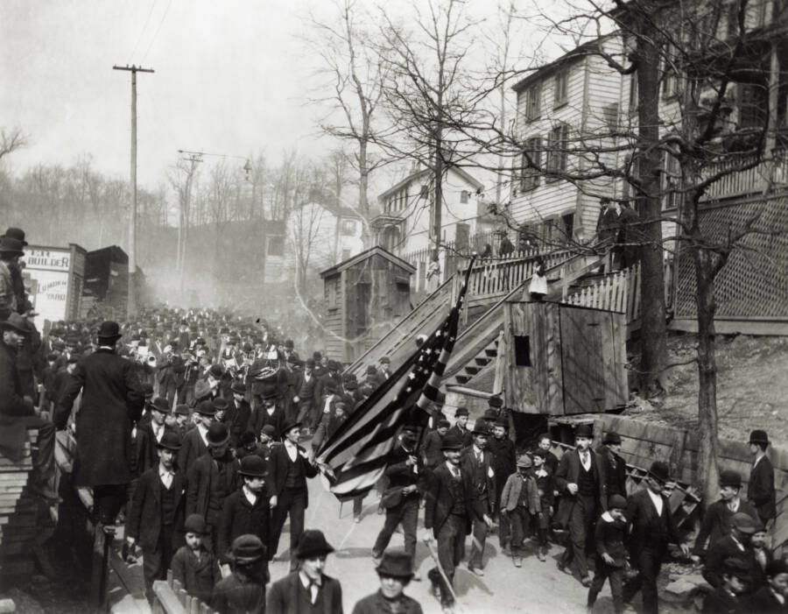
Calls for change
Thomas Paine: Agrarian Justice
Economic depressions (1840s, 1890s, 1930s) and work, health, family change
Protests and plans:
- Coxey’s March
- T. Roosevelt
- Share Our Wealth
- Townsend Plan
State Old-Age Pensions
Notes:
There were calls for change throughout America’s history.
One of the first people in America to propose a retirement security plan akin to what we now call social insurance was Revolutionary War figure Thomas Paine. He called for an inheritance tax to fund a one-time stipend for each citizen at age 21 to give them a start in life, and annual benefits to every person age 50 and older to guard against poverty in old-age.
The real turning point came as the Industrial Revolution as transforming the majority of working people from self-employed agricultural workers – who could usually provide at least a bare subsistence for themselves/family – into wage earners, where economic security was threatened by outside factors such as recessions, layoffs, failed businesses, etc. As breadwinners moved to cities, families became smaller, making it harder for families to support older or infirm family members. Better health care and sanitation, and more effective public health programs, meant Americans began to live significantly longer.
As Americans began to experience the economic depressions that are capitalism’s hallmark, they realized that in an industrialized society the threat to economic security represented by unemployment could strike anyone -- even those able and willing to work. Protest movements arose.
The photo is of the March of Coxey’s Army. Coxey was an unsuccessful Ohio politician and industrialist who, in 1894, called on the unemployed from all over the country to join him in an "army" marching on Washington. Ten of thousands of unemployed workers started marches, but by the time Coxey and his group finally made it to Washington only about 500 hard-core believers remained. Coxey himself was promptly arrested for walking on the grass of the Capitol Building and the protest fizzled out. Coxey later became an advocate of public works as a remedy for unemployment and ran for president as the Farmer-Labor party candidate in 1932 and 1936.
Theodore Roosevelt’s address to the 1912 convention of the Progressive Party made a strong statement on behalf of social insurance, which we’ll talk about more in a minute.
Share Our Wealth: called upon the federal government to guarantee every family an annual income of $5,000 for the necessities of life: a home, a job, a radio and an automobile – and limiting private fortunes to $50 million, inheritances to $5 million, and annual incomes to $1 million. Everyone over age 60 would receive an old-age pension. It immediately became a movement. By 1935 the movement had 27,000 local clubs and 7.7 million members.
Townsend Plan: government provides a pension of $200 per month to every citizen age 60 and older, funded by a 2% national sales tax. By 1935, there were 7,000 Townsend Clubs with more than 2.2 million members across the country.
Between 1930 and 1935, 30 states enacted some form of old-age pension – but these were generally inadequate and ineffective. Only about 3% of the elderly were actually receiving benefits under these plans, and the average benefit amount was about 65 cents a day.

Slide 7
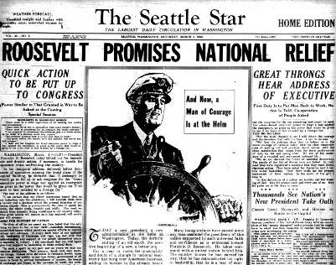
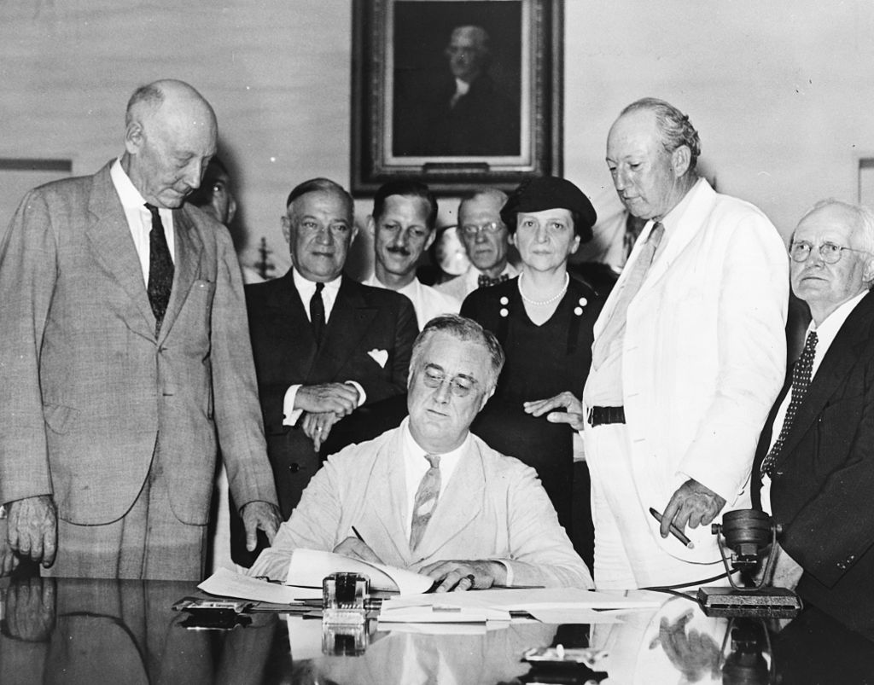
Social Security: Birth & growth
1935: State grants, federal old-age benefits for workers
1939: Added dependents and survivors benefits
1950s: Benefits increased, added disability insurance
1960s: Eligibility age lowered, Medicare created
1970s: Automatic COLA, Supp. Security Income (SSI)
1983: Payroll tax, Trust Fund, increase age for full benefits
Notes:
In the wake of the Great Depression, Franklin Roosevelt took up the call for “social insurance” as a government-sponsored effort to provide a measure of economic security for its citizens. It came to be seen as a reasonable, practical alternative to more radical calls for action.
The idea of social insurance is to "insure" people in some way against the risk of death, disability or unemployment causing loss of work, and therefore income. The “social” element means that 1) it is shaped by social objectives rather than self-interest, and 2) individual risk and cost is minimized through a large risk pool, which requires everyone to participate.
After completion of a 6-month study, Roosevelt submitted a detailed legislative proposal to both Houses of Congress in early 1935. There were some close votes in committees, but the bill passed both houses overwhelmingly in floor votes, and was signed into law on August 14, 1935.
In addition to funding states for provision of certain welfare programs, the new Act created a federal social insurance program designed to pay retired workers age 65 or older a continuing income after retirement, which is what we think of as Social Security today.
Amendments in 1939 added payments to the spouse and minor children of a retired worker (so-called dependents benefits), and survivors benefits paid to the family in the event of the premature death of a covered worker. This change transformed Social Security from a retirement program for workers into a family-based economic security program.
Subsequent amendments added new categories of benefits: payments to the spouse and minor children of a retired worker (so-called dependents benefits) and survivors benefits paid to the family in the event of the premature death of a covered worker. This change transformed Social Security from a retirement program for workers into a family-based economic security program.
Later amendments greatly increased the value of benefits, provided for annual cost-of-living adjustments, and consolidated a patchwork of existing state programs for “adult categories” of needy aged, blind and disabled individuals into SSI, run by the SSA. The creation of Medicare extended health coverage to almost all Americans aged 65 or older.
The last significant change was made in 1983, when Congress increased payroll taxes and reduced future benefits for millions of Americans in order to build a surplus in the Social Security Trust Fund for the Baby Boomer generation’s retirement. Ended survivors benefits for students in college.

Slide 8
Social Security today
Retired workers: Age 62+ with at least 10 years work (including noncitizens). For most workers, full benefits at age 67.
Disabled workers: With 18 months work (depending on age).
Dependents: Children, adult disabled children, spouse, elderly parents.
Notes:
So with that history in mind, let’s talk about Social Security in the present day.

Slide 9
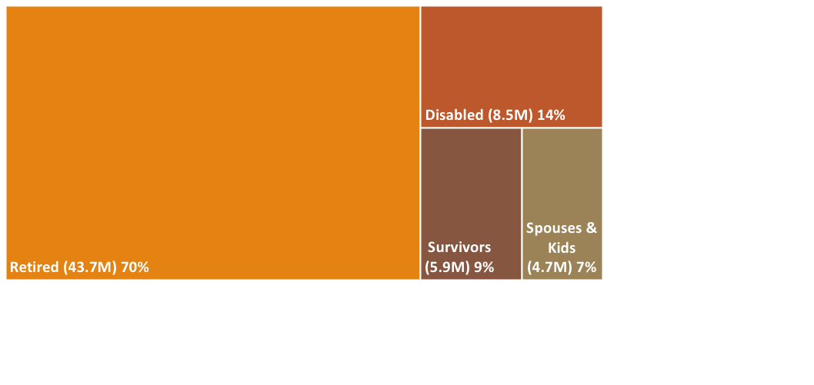
1 in 3 U.S. households benefit
62.9 million beneficiaries nationwide (2018):

Slide 10
Best poverty-fighter, bar none
Notes:
Today, seniors have the lowest rate of poverty among Americans – and it’s thanks to Social Security. Even though average retirement benefits are just $1,490/month ($17,880/year), Social Security kept an estimated 317,000 Washingtonians age 65 or older from living in poverty in 2018.
Nationwide, Social Security keeps more than 1.4 million children and 7.9 million adults age 18-64 above the poverty line.

Slide 11
Supports families & economy
In Washington (2018):
Nearly 108,000 widow(er)s and children received an average $1,291/month ($15,489/year) for survivor’s benefits.
More than 207,000 workers and their families received an average $1,301/month ($15,616/year) for disability benefits.
Benefits generated an estimated $42.3 billion in economic activity, more than 268,000 jobs, nearly $2.2 billion in state and local tax revenue.
Notes:
Primary insurance protection for 95 percent of Washington’s 1.8+ million children and families.
Benefits equivalent to 5 percent of state total personal income in 2018.

Slide 12

Looking Ahead
Notes:
Let’s turn our attention to the future, to the challenges and opportunities we face. And I’d like to begin by giving you some economic context for the decisions we’re collectively facing.

Slide 13
Growth in wage inequality
Notes:
We’ve seen a steady growth in wage inequality over the past 40 years. Those at the top are getting ahead, those in the middle are standing in place, in terms of wage gains. These wages are adjusted for inflation, but keep in mind that costs for crucial goods and services like housing, health care, higher education, and child care have outpaced overall inflation, especially over the past decade.
The routine financial advice is to put aside 10% of one’s paycheck for retirement. But in 27 of Washington’s counties, a family of four with both adults working full-time at or just below their county’s median wage doesn’t earn enough meet expenses for a modest standard of living and have even 5% left over.

Slide 14
Private retirement benefits
Notes:
People with a retirement savings plan at work are 15 times more likely to save. But for decades, employer-sponsored retirement plans have failed to fill the gap between what Social Security provides and what people need – especially, but not only, for lower-income workers.
Among U.S. private-sector workers with below-average wages, just 56% of have access to an employer-sponsored retirement plan, and only 36% actually participate. But even among workers with above-average wages, about 1 in 6 don’t have access and nearly 30% don’t participate.

Slide 15
Average savings look good
Notes:
This data is from the Federal Reserve Survey of Consumer Finance – pretty solid material! – and it illustrates average savings by age group. As you can see, people here in this 60-64 age group seem to be doing alright. I mean, sure they’d probably prefer to have $1 million saved at this point, but half a million is something.
Pop quiz: if most people aren’t earning more, and many people don’t have access to retirement savings plans at work, why do average savings look this good?

Slide 16
High incomes = high savings
Notes:
The answer lies in the average. When you get a few people saving a lot, it pulls the average up. Here’s what I mean. This is what the savings picture looks like at the 90th percentile – in other words, for the top 10% of retirement savers.

Slide 17
Typical savings are dismal
Notes:
And here is what savings look like at the median, where half of the people have more, and half have less saved. This is the middle class, right here.
The impact of wage inequality is simple: you can’t save what you don’t earn. And it’s exacerbated by an access problem: you can’t save when you don’t have a place to put it. And unless you choose a Roth IRA, you’ll face penalties for withdrawing those funds early.
One recent study found that if faced with a $400 emergency expense, four in 10 American adults would either borrow, sell something, or not be able to pay; more than one in six adults are not able to cover their current month's bills, and one in four skipped necessary medical care in the past year due to an inability to pay. One in four participants in defined contribution plans will tap into some or all of such plans for non-retirement needs.

Slide 19
Lower-income workers retire earlier – with lower benefits
Notes:
In my next slide, we’ll turn specifically to Social Security’s challenges and opportunities, but I want to give you one more insight into the lives of today’s retirees.
More than 4 in 10 retirees retire earlier than they had anticipated – most often because of a health problem or disability, or changes at work such as a downsizing or workplace closure. For every month a person claims their Social Security retirement benefit before reaching full retirement age, their initial monthly benefit is permanently reduced. (US Census Bureau Current Population Survey, 2017)
As shown, lower-income workers tend to retire earlier than those with higher incomes: average labor-force participation rates for those age 55 and above are lowest for those with a high school diploma or less, and highest for those with a BA degree or more. (While education isn’t a perfect proxy for lifetime earnings, the two are highly correlated.) This represents an overall reduction in lifetime benefits – especially for workers in physically demanding jobs, or for whom life expectancy is lower than average due to socioeconomic or other circumstances.

Slide 20


Social Security’s finances
$25 billion
Trust Fund 1982
$2.8 trillion
Trust Fund 2020
79% of benefits
from 2035 if no action
Notes:
The last challenge I want to talk about is Social Security’s finances. I deliberately put this last – not because it is less significant, but because as a nation, we have time to address it.
The reason we have time is because in the early 1980s, Congress increased payroll taxes and reduced future benefits for millions of Americans in order to build a surplus in the Social Security Trust Fund for the Baby Boomer generation’s retirement.
It largely worked as planned; the latest Trust Fund report projects Social Security can pay all benefits in full and on time until 2035, and 79% of scheduled benefits thereafter, even if Congress takes no action.
Should the Trust Fund run out, Social Security will revert to doing what it did for decades, right up until the 1980s reforms: it will run as a “pay as you go” system, and pay limited benefits.
I want to stress that there’s no need for that to happen. The projected shortfall is equivalent to about 1% of GDP, which is a very manageable number for an economy like ours. In fact, many nations with advanced economies do quite well by paying a far higher percentage of their GDP for their equivalent programs.
Given where most people are economically, cuts to Social Security – whether they take the form of outright benefit reductions, more limited COLAs, or a retirement age increase – will only serve to further diminish economic security for nearly all Americans.
And any such changes will disproportionately affect low- and middle-income families, women and workers of color, who (unlike wealthy individuals) more often do not have significant retirement savings and must work further into old age in more difficult and demanding jobs.
As we consider policy options for Social Security, I hope I’ve made the case for not only changing Social Security, but reforming many aspects of the American economy.

Slide 21
Lawmakers need to focus on:
Affordability:
  Housing
  Health care
  Child care
  Higher education
Wages and benefits:
  Minimum wage
  Unionization
  Paid family leave
  Paid sick leave
  Overtime
Notes:
Policy changes: There are a whole host of public policy changes that would create a better economic environment for the vast majority of typical Americans. Broadly speaking, they fall into two buckets.
The first is affordability, and reflects the need to tackle housing, health care, child care, higher education and other crucial goods and services that support economic security for all and a stronger economy overall.
The second is wages and benefits, and reflects the need to improve people’s incomes. This includes raising the federal minimum wage and eliminating the tipped minimum wage, making it easier to form and/or join a union, enacting robust paid family leave and paid sick leave laws, ending typical prison labor agreements, and more.

Slide 22
Lawmakers need to focus on:
Social Security:
“Scrap the cap” on taxable wages
Raise benefits overall
Protect the very elderly
Reduce gender and racial inequities
Restore student survivor benefits
Adopt the CPI-E index
Restore office access and services
Notes:
Social Security’s benefits are (nearly) universal, the program is incredibly efficient, and the benefits are guaranteed. The case for expanding and improving the program is overwhelming. The question of whether to do so isn’t about affordability – it’s about our values as a nation, and those we elect to represent us in office. More on that in a minute. Let’s take a look at some of the opportunities we have to improve Social Security.
Scrap the cap: Today, workers and employers each pay 6.2 percent of wages to finance Social Security, but there’s a cap on taxable wages ($137,700 in 2020). So while 94 percent of workers pay Social Security tax on every paycheck, most of the earnings of the top 1 percent, and especially the top 0.1 percent, escape being taxed. In fact, on Wednesday, a person with a $1 million yearly income would have stopped paying Social Security payroll taxes.
Ensuring every American pays the same effective tax rate on their wages would eliminate 84 percent of the Trust Fund’s projected shortfall. Only the richest 6.1 percent of workers (less than 1 in 15) would pay more. And it’s a popular idea: two-thirds of Americans support requiring high-income workers to pay Social Security taxes on all of their wages (as is already the case with Medicare taxes).
(Set by Congress in 1977 and indexed to average wage growth, the cap was intended to cover 90 percent of all wages. But over the past several decades, wage growth for low- and middle-income Americans has slowed, while wages at the top have grown dramatically. As a result, the cap now covers just 83 percent of aggregate wages.)
Raise benefits overall: Adjusting the benefit formula to raise benefits for those who have had careers in low-wage occupations – such as childcare, restaurant service, or home health care – would better protect the financial security of people just scraping by, particularly older women and people of color.
Protect the very elderly: Living to extreme old age, or living without a spouse greatly increases the risk of poverty. “Bump-ups” in benefits for seniors living past a certain age and increasing benefits for elderly widow(er)s would reduce financial insecurity among these vulnerable people.
Reduce gender and racial inequities: Caring for children or aging family members can cause many people, especially women, to reduce time in the workforce, greatly affecting their retirement benefits. Reducing the number of years’ earnings used to calculate benefits from 35 to 28 can eliminate the caregiving penalty. It would also help those with reduced access to employment due to recessions, discrimination, local economic conditions or disasters, and other barriers.
Restore student survivor benefits: Before 1981, children of retired, deceased, or disabled workers continued receiving benefits through age 22 if they attended college. Now benefits end once a young person both turns 18 and finishes high school. Reinstating college benefits could help children and their families achieve their dreams, as well as reduce socioeconomic barriers to education and lifetime opportunities.
Adopt the CPI-E inflation index: Over the past decade, Social Security’s existing cost of living adjustment (COLA) formula has led to average increases of about 1.4 percent per year. However, comparatively larger increases in Medicare premiums have often meant many seniors see no additional income from COLAs. Adopting the consumer price index for the elderly, or CPI-E, would more accurately calculate adequate COLAs for retirees.
Restore office access & services: The Social Security Administration’s (SSA) expenses are self-funded and account for less than one penny of every dollar spent. But from 2010 to 2019, its operating budget fell nearly 11 percent in inflation-adjusted terms — even as the number of Social Security beneficiaries grew by 17 percent. SSA staffing levels have declined by 12 percent since 2010, hampering its ability to perform its essential services. Restoring full funding would help ensure people have dependable and easily accessible in-person service at Social Security offices, often at critical moments in their lives.

Slide 23
Promising federal legislation
Social Security 2100 Act (H.R. 860/S. 269)
Social Security Expansion Act (H.R. 1170/S. 478)
Strengthening Social Security Act (H.R. 2654)
Protecting and Preserving Social Security Act
(H.R. 2302/S. 1132)
Social Security for Future Generations Act (H.R. 4121)
Notes:
It’s common for pundits to state that Congress has no plan to address Social Security’s projected shortfall. That is incorrect.
It is true that Congressional Republicans have no plans – at least, none they seem willing to publicly embrace. Perhaps that is because their preferred “solutions” most often involve cutting benefits, which is overwhelmingly opposed by voters across the political spectrum, including the Republican base.
By contrast, congressional Democrats have introduced several measures. I’ve noted 5 here, and want to highlight two of them – the Social Security 2100 Act, introduced by Rep. John Larson (CT), and Social Security Expansion Act, introduced by Sen. Bernie Sanders (VT) – which special mention.
Both bills would not only ensure all promised benefits are paid in full and on time for the foreseeable future – they would also implement more sensible cost-of-living adjustments for seniors, increase Social Security’s modest benefits, and lift the cap on taxable earnings to ensure the wealthy pay their share.
The Social Security 2100 act has 208 cosponsors in the House – and prior to impeachment proceedings getting underway, seemed to have a shot at getting hearings. We remain hopeful, even though the legislation would not have passed the Senate, because it shows a clear path forward and shows a great number of Representatives have an appetite to tackle these changes.

Slide 24
2020 Presidential Candidates
 | Biden | Bloomberg | Buttigieg | Gabbard | Klobuchar | Sanders | Steyer | Warren | Trump
Change payroll tax cap
Raise payroll tax rate
Broaden tax base
Increase minimum benefit
Increase survivor benefits
Create caregiver credit
Use higher price index for COLA
Notes:
Social Security has become an indirect focus of the 2020 campaign, and we continue working with allies across the country to get a debate moderator to ask a specific question of the candidates as to how they would change/improve Social Security if elected.
No single chart can capture all of the subtleties of a candidate’s proposal, but I’ve cribbed this from a recent New York Times article to give you a flavor.
Mr. Steyer has proposed to expand “retirement security programs,” but is unclear on specifics.
Mr. Bloomberg says he will “consider options for preserving and strengthening Social Security’s long-term finances, while maintaining and enhancing benefits for the neediest recipients” but is unclear on specifics. His plan does not overtly endorse Social Security cuts. In the past, Mr. Bloomberg has supported raising the retirement age, compared it to Bernie Madoff’s Ponzi scheme, and was an enthusiastic supporter of the Bowles-Simpson austerity commission, which advocated Social Security cuts.
Mr. Biden’s campaign website supports making Social Security more generous. However, Biden’s past comments make clear that he has at least been willing to keep cuts to Social Security and Medicare (such as raising the age of eligibility or recalculating cost-of-living increases for these programs) as negotiating chips, while other Democrats have taken a harder line that any cuts cannot be part of budget negotiations. For an in-depth review of Biden’s position, refer to FactCheck.org.
President Trump has not proposed substantive policy changes to Social Security. His 2021 budget proposes cuts to Medicaid, food stamps, Social Security Disability Insurance, as well as Medicare spending reductions over ten years, most of which would come from reducing payments to health care providers.
For the most part, the budget does not reflect the President’s efforts to end the Affordable Care Act (ACA) or his executive order calling for various Medicare changes. However, Republican members of Congress are on record stating the president has expressed openness to the idea of cutting Medicare and Social Security as a “second-term project”. And Trump himself has opened mused about cutting entitlements in his second term.

Slide 25
Policy development principles
Everyone should be able to live with dignity in retirement.
Most people will need resources beyond Social Security.
Most of us need a “nudge” to save for the future.
A secure, affordable way to save at work is essential.
Notes:
But we don’t have to wait for federal action. Here in Washington, EOI is also working on state proposals to improve retirement security. We began with four principles in mind.

Slide 26
State Policy Models
Secure Choice:
Auto-IRA: State opts-in workers w/o retirement plan to IRA.
Worker contributions only; managed by private financial services providers.
Limited benefit for those below median income. Relatively high fees. All risk on individual participants.
Legislation passed WA Senate in 2019; introduced again 2020. Programs in place: OR, CA, IL.
Potential next steps: Improve consumer protections, mandate future review.

Slide 27
State Policy Models
Supplemental Social Security:
Social insurance: state administers benefits, funded by payroll premium.
Employers and employees both contribute; public management.
Proportionally higher benefits for lower-income workers. Pooled accounts reduce risk and fees.
WA has related experience with Paid Family and Medical leave and Long Term Care.
Potential next steps: Budget proviso for actuarial analysis of various models, policy development.

Slide 28
Further action
Social Security Works
https://socialsecurityworks.org/
Social Security Works - Washington
https://ssworkswa.org/
Puget Sound Advocates for Retirement Action
https://psara.org/
Washington State Senior Citizens’ Lobby
http://www.waseniorlobby.org/
Notes:
You’ve all been very patient and great listeners. I’ll leave you with the names of one national and several local organizations, besides EOI, that do a great deal of work around issues of retirement security.

Slide 29

Thank You
Aaron Keating
206-529-6371
aaron@opportunityinstitute.org
Notes:
Thank you for your time and attention!

